Slide 1
RecSys Project
Matteo Gläser, Ilyas Satik, Sonja Dagn

Slide 2
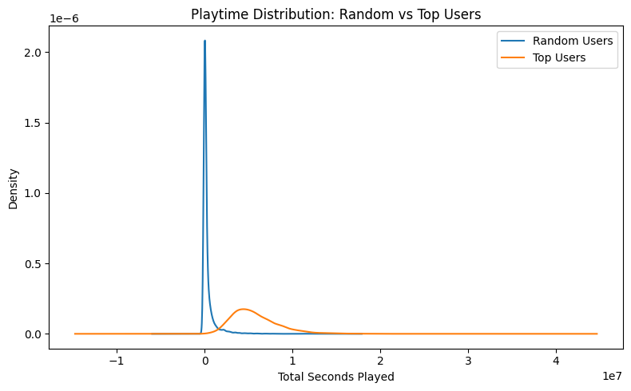
User Analysis – Playtime Distribution
Random Users (blue curve)
extremely concentrated near zero playtime
Top Users (orange curve)
much wider spread
peak well to the right of zero
logged substantially more total playtime
There is almost no overlap
except near the origin
Top Users dominate higher playtime buckets
Random Users’ density has effectively dropped to zero

Slide 3
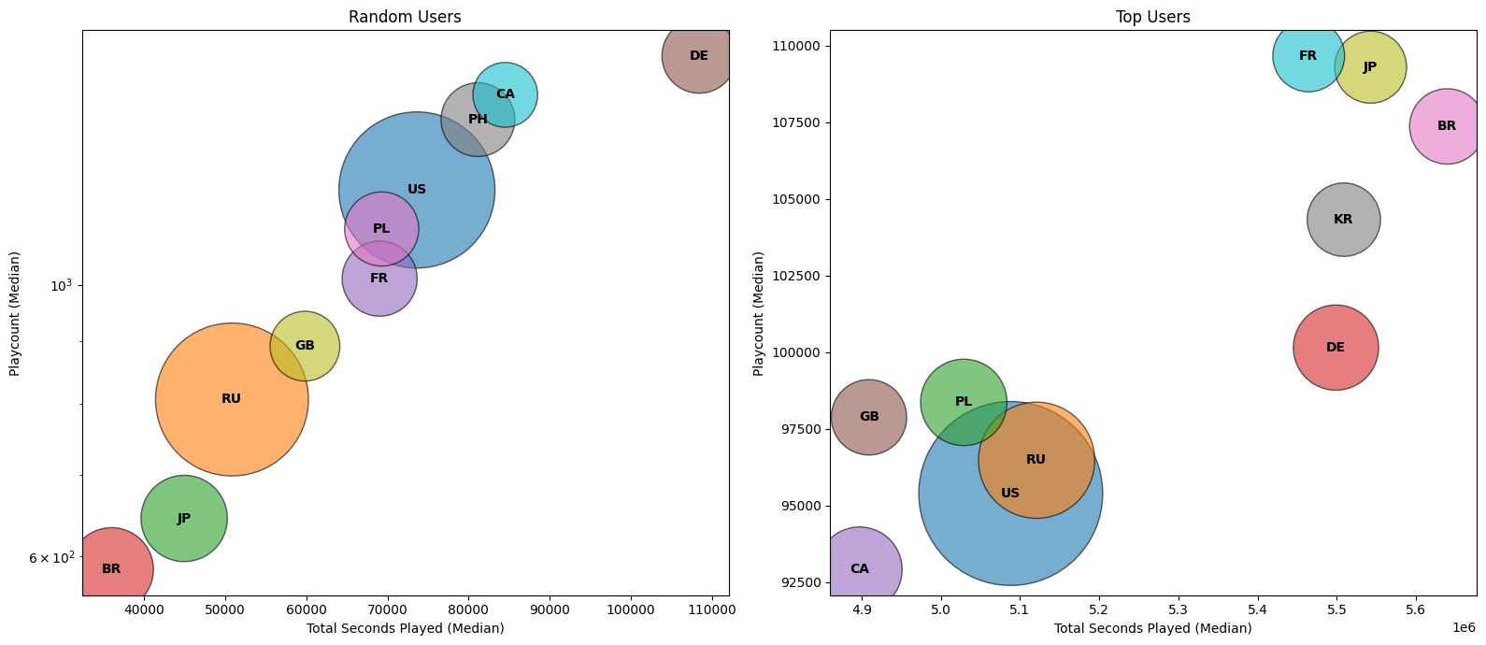
User Analysis – Median Playtime vs. Playcount by Country
Random users
cluster at much lower medians
playtime around 35 000–110 000 s
playcounts of 600–3 000
with Russia and the US having the largest bubble sizes (most users)
Top users
sit at multi-million seconds (≈4.9–5.6 M s)
very high playcounts (≈93 000–110 000)
again with the US and Russia largest
Countries shift rank:
e.g., Brazil moves from lowest medians among random users to high medians among top users
The vertical gap between plots
top users play dozens of times more than random ones
Bubble sizes (user population)
remain similar in relative order
shift right/up dramatically for top users

Slide 4
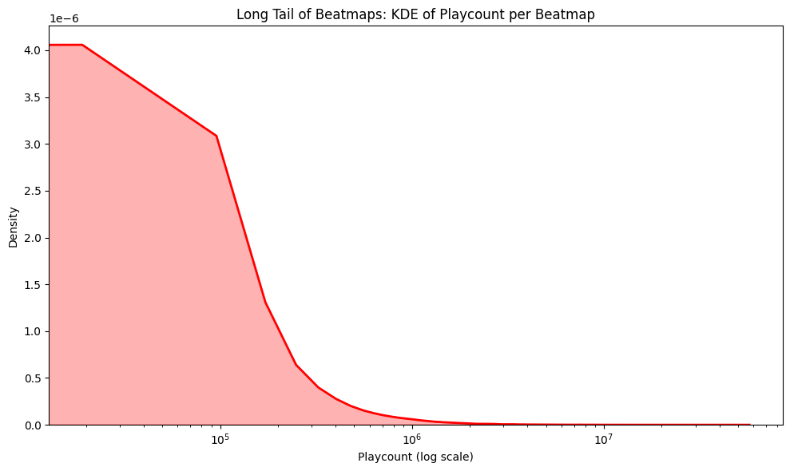
Beatmap Analysis – Long Tail of Beatmaps
vast majority of beatmaps
very low playcounts
small number of beatmaps
accumulate extremely high playcounts
forming a heavy “long tail”
Curve highlights
extreme imbalance between a few blockbusters and many niche maps

Slide 5
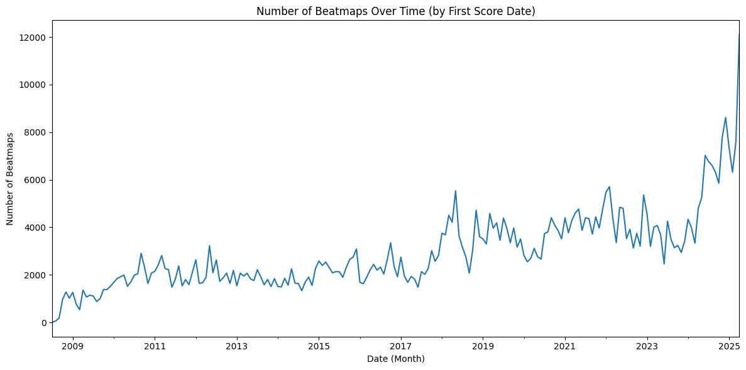
Beatmap Analysis – Number of Beatmaps over Time
Launch in 2008:
new beatmap submissions rose quickly
From 2010–2016
map creation fluctuated between ~1 500 and 3 000 monthly
Late 2017
sharp surge ,peaking around 5 000–6 000 monthly
likely driven by increased player activity and tooling improvements
Between 2019–2022
monthly submissions stabilized around 3 000–5 000
occasional spikes
Starting in 2023
dramatic uptick occurred
By early 2025
7 000 - 10 000 new maps per month
indicating renewed growth in community mapping

Slide 6
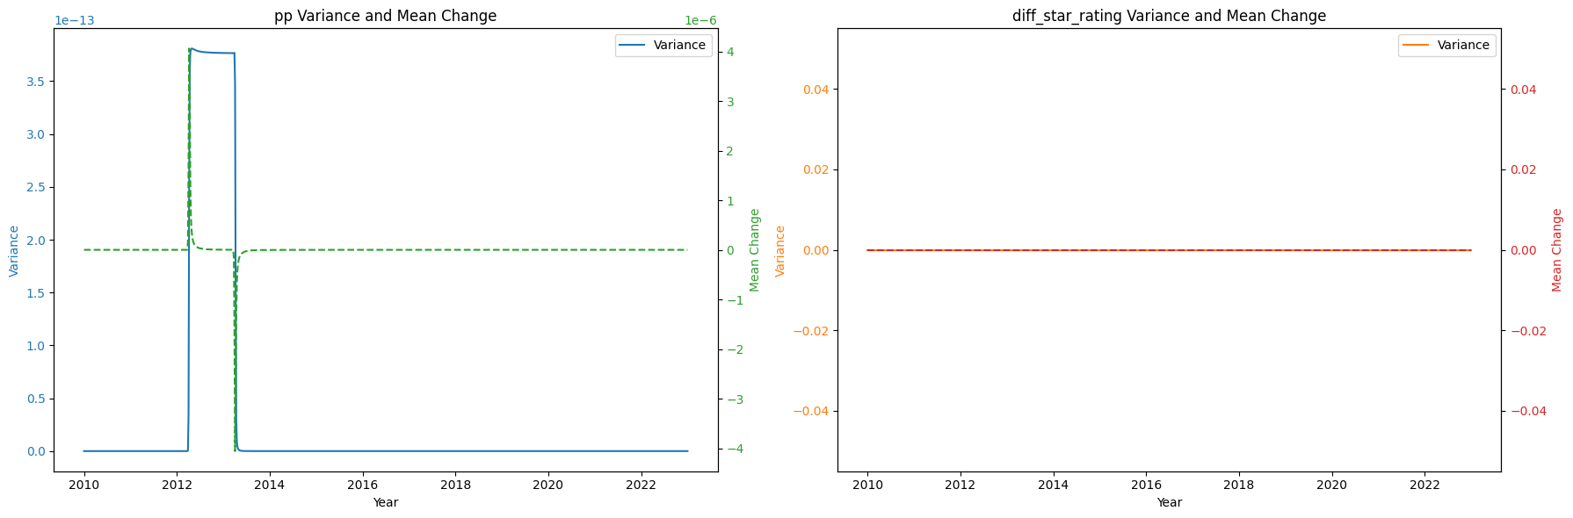
Score Analysis – Temporal Volatility: Performance‐Point vs. Star‐Rating
Performance Point (left)
the variance of changes (solid blue) spikes dramatically around 2012, collapses by 2014, and thereafter remains essentially zero—indicating a brief period of extreme fluctuation followed by long‐term stability
The mean change in pp (dashed green) mirrors these bursts, peaking when variance peaks and settling back to nearly zero once volatility subsides
Star-Rating (right)
both the variance (orange) and mean change (red) of star‐rating differences remain flat at zero throughout 2010–2023—showing that star ratings themselves have been highly stable with no measurable year‐to‐year drift

